Slide 1
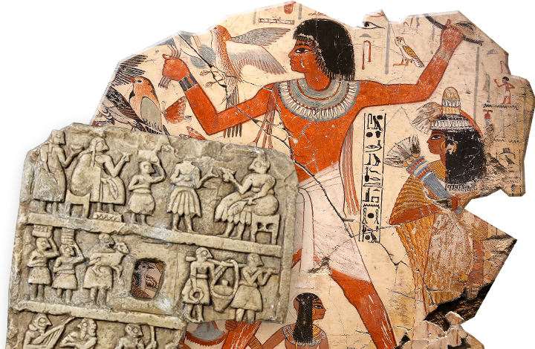
PORTFOLIO TASK Power in the Ancient World
Goal/s:
Discuss the requirements and expectations of PORTFOLIO TASK
Week 15 Lesson 1
Ms Barrie

Slide 2
Project Overview
Task Booklet

Slide 3

PEER and SELF EVALUATION
You will receive ONE evaluation sheet. Write your name on it, and keep it with your completed poster on your desk.
TWO (2) people must evaluate your work. They must assess based on the criteria, and leave 2 comments.
Once complete, finish the SELF EVALUATION form.
Staple both sheets to your poster, and submit to Ms Barrie.

